Slide 1

WELCOME TO THE VERY FIRST WORKSHOP IN MLDA DEEP LEARNING WEEK!

Slide 2
MLDA@EEE DEEP LEARNING WEEK FLOW
Text Generator Using RNN
Intro to CNN
Intro to Reinforcement Learning
Transfer Learning

Slide 3
In this workshop, we assumed that…
You have attended the workshops in pre-deep learning week...
OR
Have basic knowledge of python programming, deep learning as well as neural network…
OR?
…

Slide 4

TEXT GENERATOR USING RNN
MLDA DEEP LEARNING WK SPECIAL:
SPEAKER:
RAO YUCHEN
IEM/YR3

Slide 5
STRUCTURE
Development of NLP
What is NLP?
Why NLP?
Text Processing Basics
RNN Basics
What is RNN?
Structure of RNN
Improvement over RNN
Extended Reading
Intro to Practical Session
PRACTICAL SESSION

Slide 6

1-1 WHAT IS NLP?
Natural Language Processing is a field of Artificial Intelligence that gives the machines the ability to read, understand and derive meaning from human languages.
A high-level standard workflow for any NLP project
https://towardsdatascience.com/a-practitioners-guide-to-natural-language-processing-part-i-processing-understanding-text-9f4abfd13e72

Slide 7
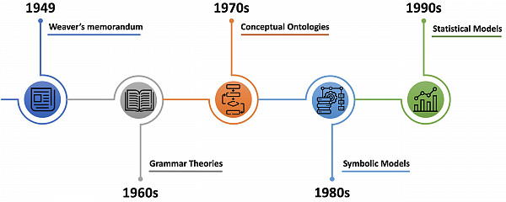
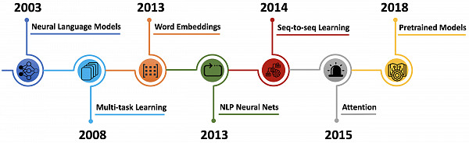
https://www.websystemer.no/a-brief-history-of-natural-language-processing%E2%80%8A-%E2%80%8Apart-2/

Slide 8


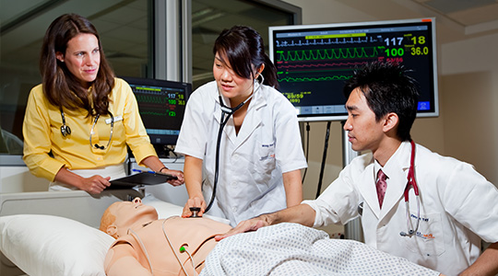
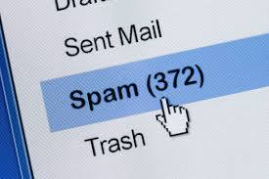
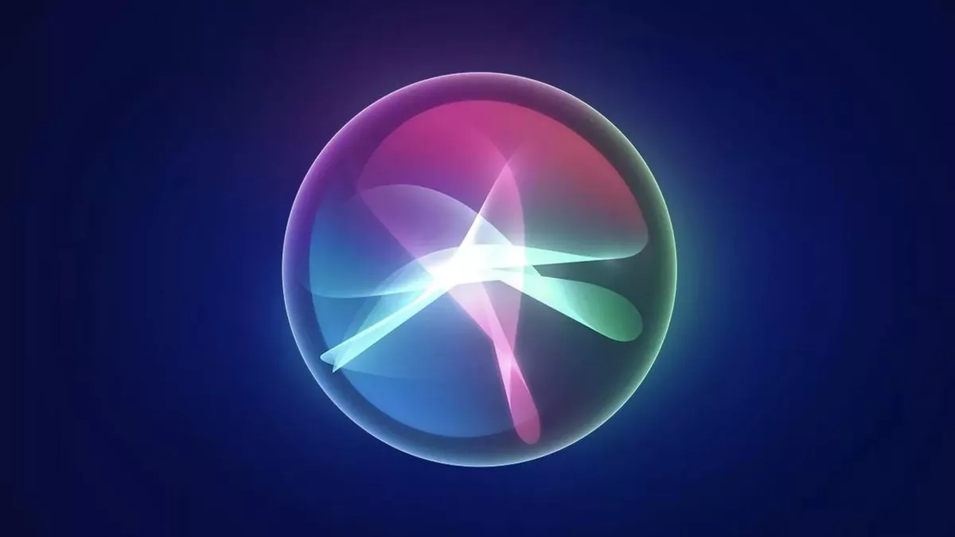

1-2 WHY NLP? – Uses of nlp IN OUR LIFE
Customer Services
Health care
Recruitment
Spam Detection
Sentiment Analysis
Conversational Framework

Slide 9
1-3 NLP BASICS FOR TEXT
Tokenization (Text to Words)
Tokenization is a way of separating a piece of text into smaller units called tokens.
I love machine learning.
Word Tokenization: [‘i’, ‘love’, ‘machine’, ‘learning’]
Character Tokenization: i- -l-o-v-e- -m-a-…
Sub-word Tokenization: i-lov-e-mach-ine-learn-ing
Corpus
A language resource consisting of a large and structured set of texts

Slide 10
1-3 NLP BASICS FOR TEXT
Stopwords: stopwords are the words in any language which does not add much meaning to a sentence.
You are now listening to my workshop…
=> [now, listening, workshop]
Padding: All the neural networks require to have inputs that have the same shape and size but not all the sentences have the same length.

Slide 11
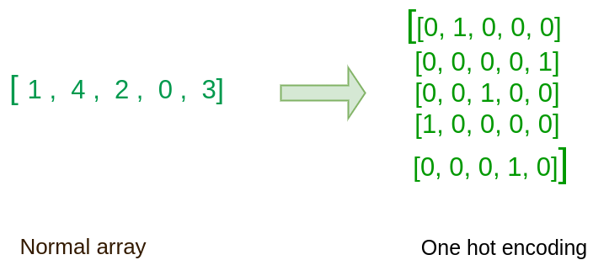
1-3 NLP BASICS FOR TEXT
One-hot vectors
The one-hot vectors’ dimension the number of unique words in the dictionary.

Slide 12
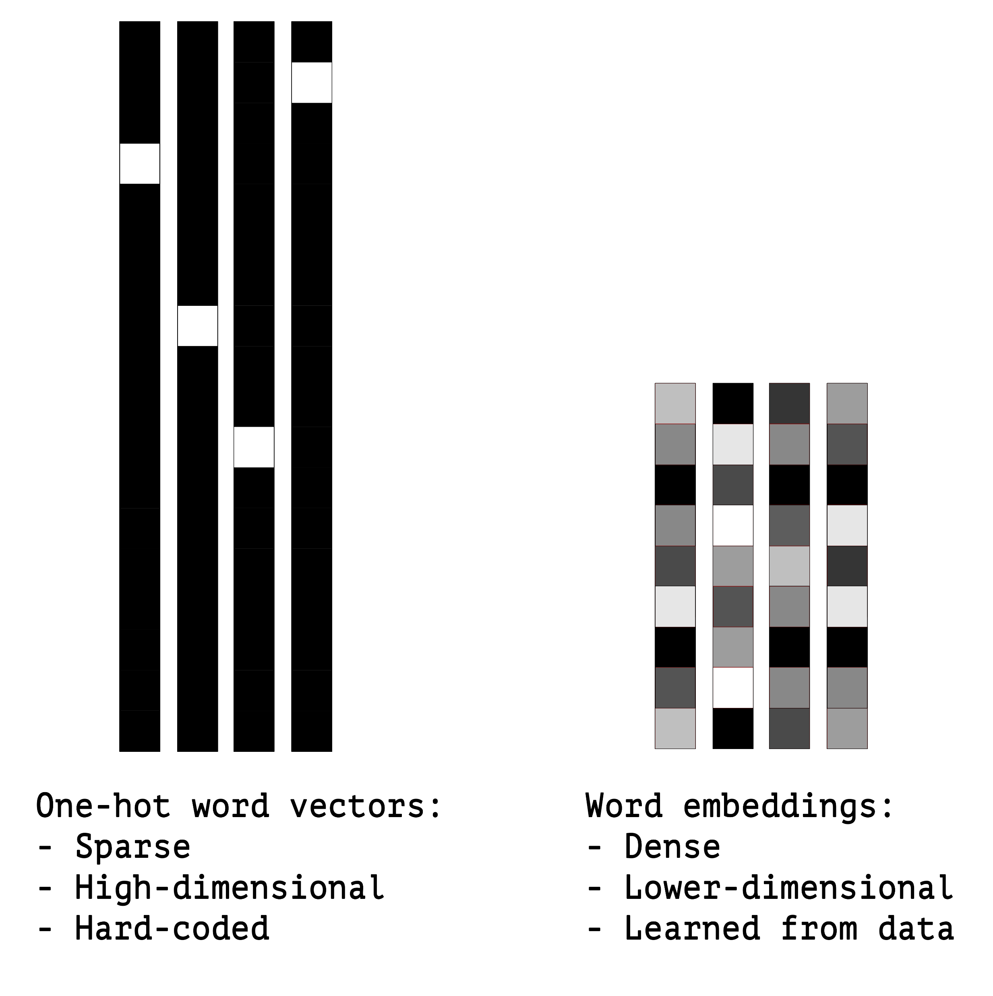
1-3 NLP BASICS FOR TEXT
Word Embedding (Word2Vec)
A word embedding is a class of approaches for representing words and documents using a dense vector representation.
The position of a word within the vector space is learned from text and is based on the words that surround the word when it is used.

Slide 13
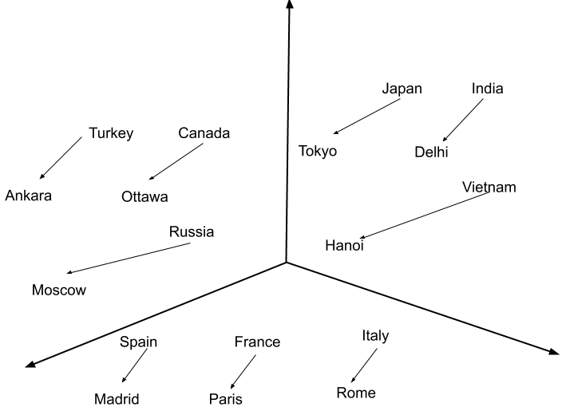
KERAS Embedding Layer
Keras offers an Embedding layer that can be used for neural networks on text data.
In Keras, the Embedding layer automatically takes inputs with the category indices and converts them into dense vectors.
Embedding(input_dim=VOCAB_SIZE,
output_dim=EMBEDDING_SIZE, input_length=MAX_SEQUENCE_LENGTH))
https://androidkt.com/how-embedding-layer-work-in-keras/

Slide 14
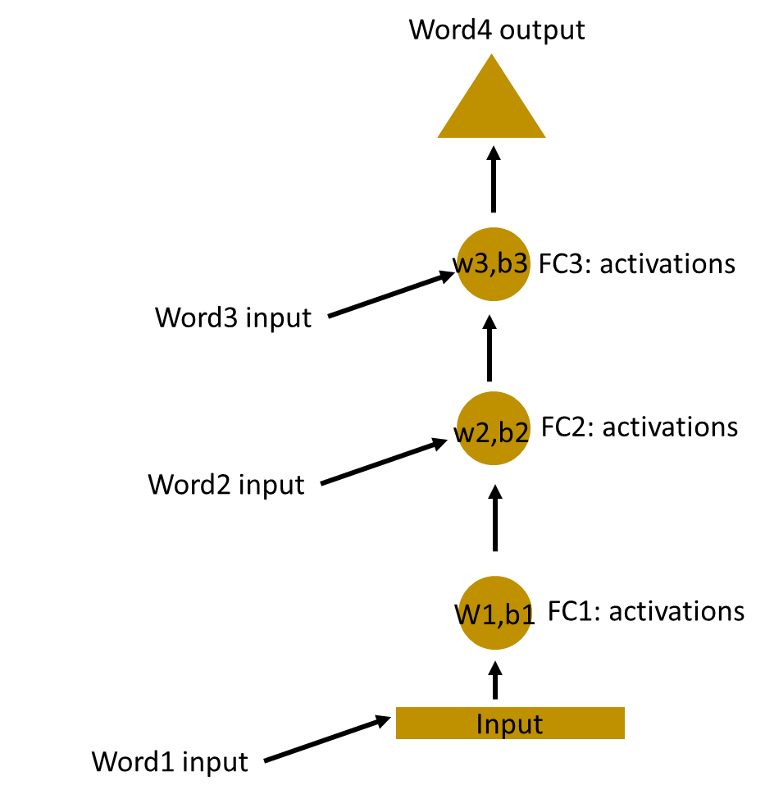
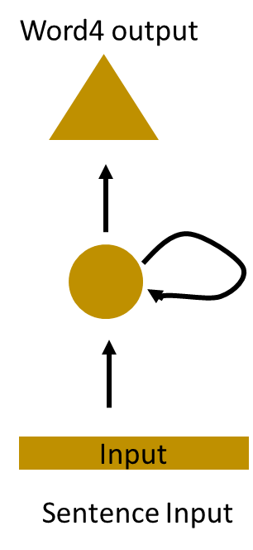
2-1 WHAT IS RNN?
deep this love but love workshop I learning I don’t
I don’t love deep learning but I love this workshop
I love deep learning but I don’t love this workshop
Recurrent Neural Network(RNN) are a type of Neural Network where the output from previous step are fed as input to the current step.
https://www.analyticsvidhya.com/blog/2017/12/introduction-to-recurrent-neural-networks/

Slide 15
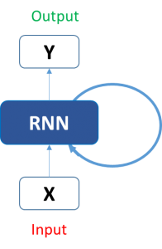
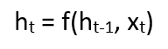
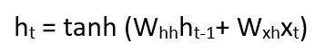
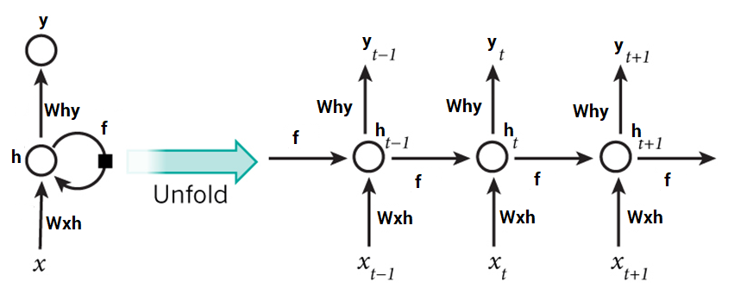
2-2-1 STRUCTURE OF RNN
https://www.analyticsvidhya.com/blog/2017/12/introduction-to-recurrent-neural-networks/

Slide 16
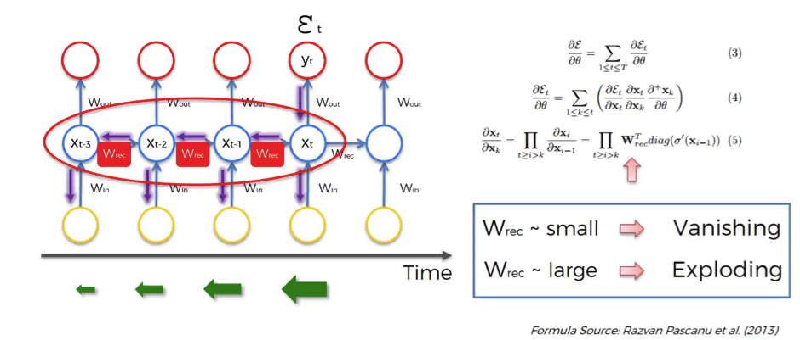
2-2-2 VANISHING GRADIENT PROBLEM
BLUE
The colour of the sky is __ __.
I spent over 20 years living in a small village in France. I then moved to Germany.
…… (100 lines)
But I can’t really speak fluent _______.
German
https://www.superdatascience.com/recurrent-neural-networks-rnn-the-vanishing-gradient-problem/

Slide 17
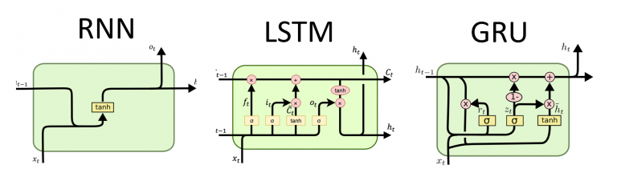
2-3 Improvement over VANILLA RNN
LONG-SHORT TERM MEMORY
GATED RECURRENT UNIT

Slide 18
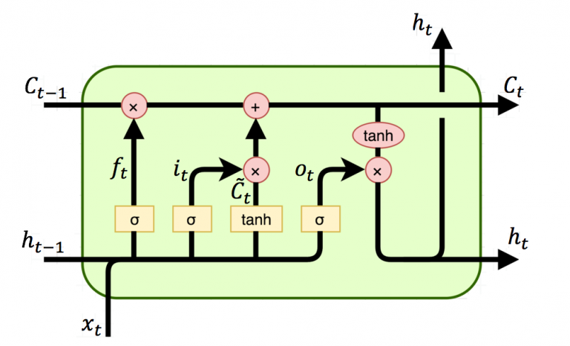
LSTM

Slide 19
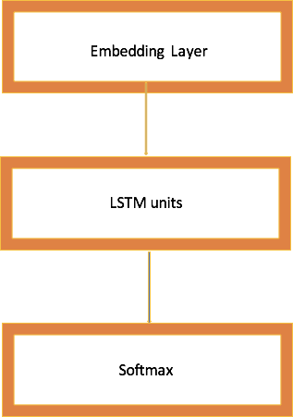
2-3 KERAS LSTM EXAMPLE
embedding_dim = 32
word_num = 2000
state_dim = 32
model = Sequential()
model.add(Embedding(vocabulary, embedding_dim, input_length=word_num-1))
model.add(LSTM(state_dim))
model.add(Dense(word_num,activation='softmax'))
model.compile(loss = 'categorical_crossentropy', optimizer='adam',metrics = ['accuracy'])

Slide 20
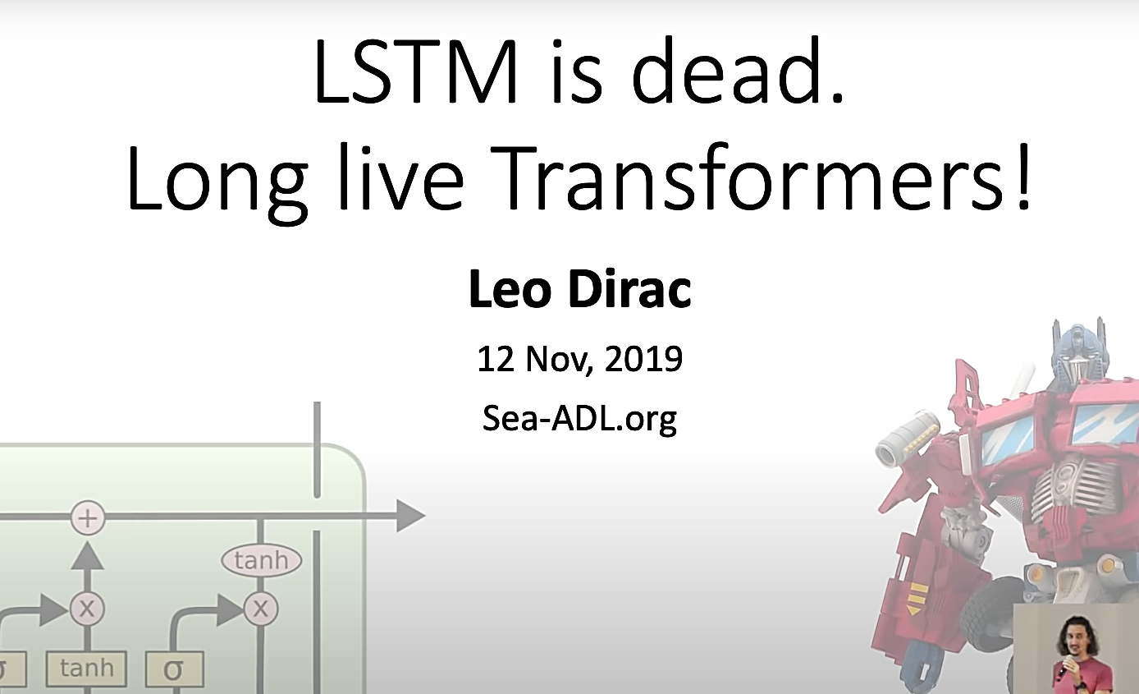
3 EXTENDED READING
Pretrained NLP Models
Multi-Purpose NLP Models
ULMFiT
Transformer
Google’s BERT
Transformer-XL
OpenAI’s GPT-2
Word Embeddings
ELMo
Flair
Other Pretrained Models
StanfordNLP
Transformers

Slide 21
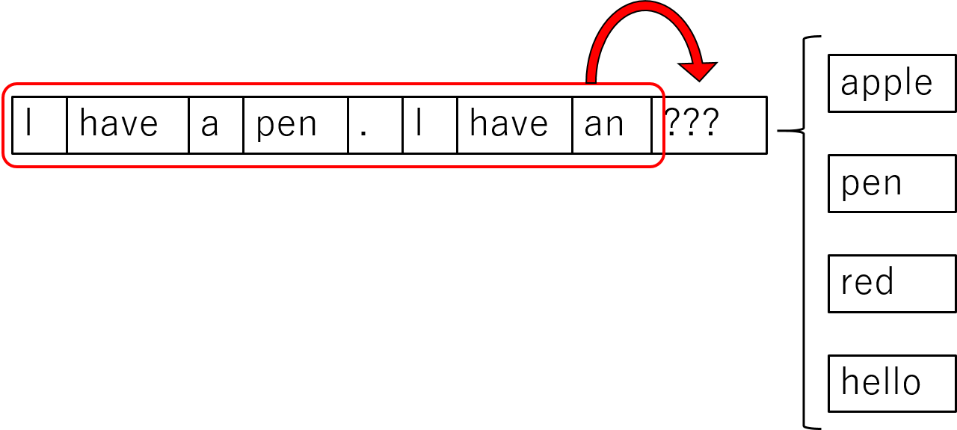
4 INTRO TO PRACTICAL SESSION

Slide 22


PRATICAL SESSION
https://colab.research.google.com/github/ycrao573/rnn-workshop/blob/master/MLDA%20Text%20Generator%20Workshop.ipynb

